Slide 1
Technical Definitions
ENCS 282 Technical Writing & Communication

Slide 2
A definition of ‘definition’
The word definition comes from the Latin word definio, which means to limit or bound.
A definition sets the boundaries of a word’s meaning(s).
How many meanings can you come up with for these terms? tone, cold, crash

Slide 3
When do I use a definition?
Offer a definition of a term or concept if one or more of the following apply:
The term or concept is unfamiliar to your audience.
You need to display your understanding by drawing a distinction between two or more concepts or objects.
The origin of the term in interesting or sheds light on its meaning or use in context
There is a lack of agreement on the term or there is some ambiguity surrounding the meaning of the term.

Slide 4
Formal Elements of Definitions
Formal Element:
Sentence Definition
Extended Definition
Parenthetical Definition
Gloss

Slide 5
Sentence Definition
A sentence definition is an explanation of a term using one sentence.
e.g.:
Aluminum is a lightweight metal that is often used for high-tension power transmission.
Parliament is a national governing body that has the highest level of legislative power within a state.

Slide 6
Extended Definition
An extended definition (or extension) usually begins with a sentence definition but then provides more specific detail about a word. They often use a paragraph or more to expand upon the meaning of a term that may be difficult to understand.
e.g.:
A microscope is an optical instrument with which the apparent size of an object can be enhanced. A simple microscope consists of a double convex lens and a magnifying glass. A compound microscope, on the other hand, will contain more than one of each of these lenses, which are situated at the ends of a cylinder.

Slide 7
Parenthetical Definition
Parenthetical definitions consist of words that quickly explain a term and are included in the same sentence as the word being defined; that sentence is usually a supplemental a part of a larger definition.
e.g.:
Phytoplankton (a kind of toxic algae) are reported at times to form mass occurrences, the so-called 'blooms'. Nearly one fourth of the three hundred species of micro algae are known to produce toxins in blooms. The scientific community refers to these events with a generic term, ‘Harmful Algal Bloom’ (HAB), thereby recognizing that not all algae blooms are are dangerous.

Slide 8
Gloss
A gloss is a definition form that is usually phrasal rather than written as a sentence, but contains a brief explanation of the defined term that is usually signaled by words like “known as, defined as, called” or devices such as “e.g. or i.e.” It is usually embedded within a sentence.
e.g.:
Another principle source of heat, known as the geothermal gradient, is the natural increase in temperature as depth increases.

Slide 9
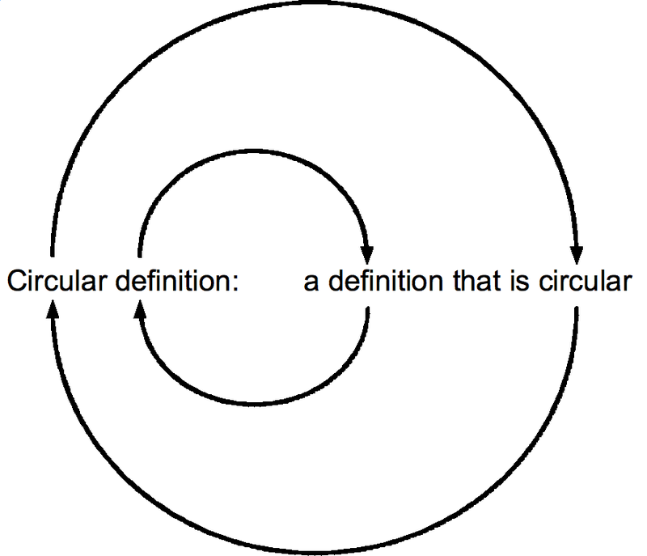
Be Careful!
Circular Definitions: The definition includes the term being defined as a part of the definition.

Slide 10
Definitions in detail
An Extended definition almost always starts with a sentence definition, but then it elaborates on the word by providing information about
function of the term defined
location or context of the term defined
physical traits of the term defined
causes and/or effects of the term defined

Slide 11
Thematic Elements of Definitions
Thematic Element:
Etymological Definition
Aristotelian Definition
Example/Analogy Definition
Comparison/Contrast
A well-formed definition will usually combine a formal element with a thematic element.

Slide 12
Etymological Definition
Etymological definitions use the meanings of a word in the past to define and understand its present meaning.
The term definition comes from the Latin word definio which means “to limit or bound”; thus, a definition sets the boundaries of a word’s meaning.
e.g.:
A herbivore is an organism that only eats plants. The word comes from the Latin words herba which means “plant or herb” and vorare meaning “to devour”.

Slide 13
Be careful
The past meanings of words may be very different or completely opposite to their present meanings.
geek |gēk|, noun informal
an unfashionable or socially inept person. [ usu. with modifier ]; a knowledgeable and obsessive enthusiast: a computer geek.
a carnival performer who performs wild or disgusting acts.

Slide 14
Words change over time
Pejoration: The process or condition of worsening or degenerating. In linguistics, it is process by which the meaning of a word becomes negative or disparaging over a period of time
e.g.:
silly: from Middle English seely, “blessed, innocent,” which has come to mean “showing a lack of good sense, frivolous, foolish.”

Slide 15
Words change over time
Amelioration: the upgrading or elevation of a word's meaning, such as when a word with a negative sense develops a positive one. Amelioration is less common than the opposite historical process, called pejoration.
e.g.:
pretty: from Old English prættig, “deceitful, cunning, clever,” which has come to mean “attractive in a delicate way without being truly beautiful.”

Slide 16
Latin, Greek and Anglo-Saxon Roots of English Words
English is a language that is made up of words borrowed from other ancient languages or earlier forms of English (Anglo-Saxon).
Many of these words are compound words (e.g. baseball, blackbird, sister-in-law) but with a linking vowel.

Slide 17
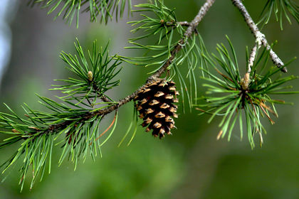
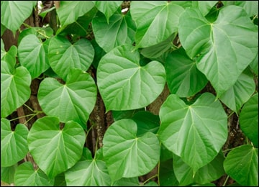
Latin compounds in English
These words are formed with a Latin “root” and a linking vowel.
conifer (cone-bearing) = con+i+fer; from conus “cone” and ferre “to bring, carry”
cordifolia (heart-shaped leaf) = cor, cordis “heart” and folium “leaf”

Slide 18
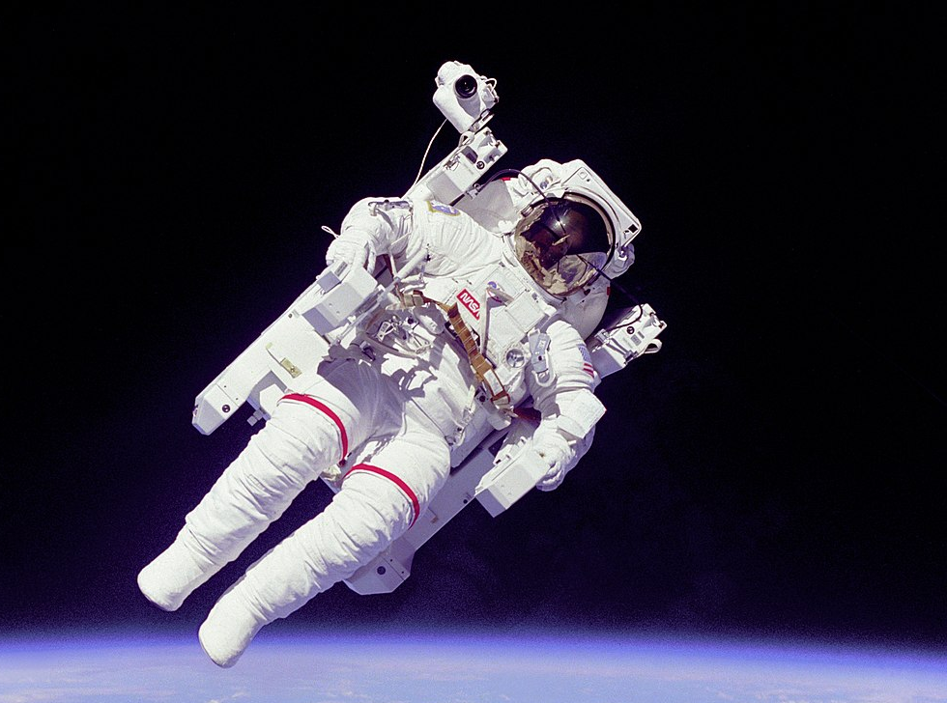
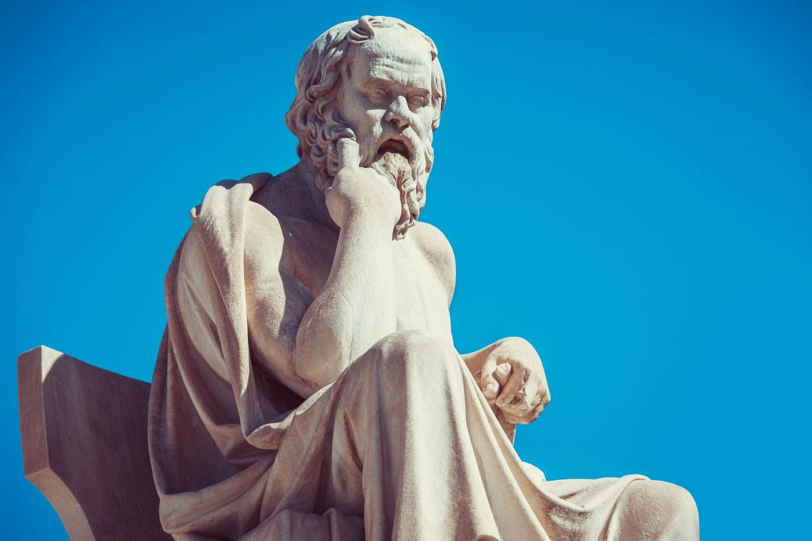
Greek compounds in English
These words are formed with a Greek “root” and a linking vowel.
astronaut (space traveller) = astr+o+naut; from astron“star” and nautes “sailor”
Philosophy (pursuit of wisdom) = phil+o+soph+y; from philia “love” and sophos “wisdom”

Slide 19
Aristotelian Definition
Term + general class + distinguishing feature(s)
Term + Species + differentia(e)
e.g.: A solar cell is a device that converts the energy of sunlight into electrical energy.

Slide 20
What can you say about the structure of these words?
Conductor
Microscope
Navigation
Palindrome

Slide 21
Etymological Definitions
Create etymological definition for these terms:
Carcinogen
Microscope
Conductor
Composite
Zoology

Slide 22
Definition by Example/Analogy
A definition by example demonstrates how the term to be defined is similar to or shares features with another term that may be more familiar to the intended audience.

Slide 23
Definition by Contrast/Comparison/Distinction
Contrastive definitions define at least two terms at the same time by setting up a comparison between them. They usual present an account of how a concept has changed over time, or they provide an overview of how experts today view the term differently than those in the past.
e.g. The former deals with…, while the latter…

Slide 24
Abstract terms
Try to write definitions for the following terms using the techniques discussed so far:
Common knowledge
Originality
Meaning
Interpretation

